Slide 1
AWS – EC2
April 2016

Slide 2
Version Sheet: MANDATORY (hidden in ‘slide show’ mode)
Version | Changes | Author
001 | Redesign | Rohan Salvi

Slide 3
Note to the SME:
Note to the SME:
This is a temporary slide and will not be part of the final upload at all. It is to help the SME understand how we will communicate changes to them.
Please read before you begin reviewing this module as SME
Dark Red box with white text
Note to the SME
The SME must provide missing info.
Amber box with black text
Note to the SME
The SME must validate the re-design/ the modification/ addition.
To Review and Navigate the comments in the presentation Click on the “Review” Tab and then Click “Next” to review all the comments . Also you can add your comments using the “New comment” button
The comments in the review section have also been updated in a green textbox with black text.
.

Slide 4
Ground Rules for Face-to-face Classrooms
Everyone participates
Respect individual opinions and diversities
Be open and honest
Give headlines, be concise
One speaker at a time
Make language a non-issue
Stick to time contracts
Seek first to understand, and then to be understood
Clean desk / room policy
No mobile phone,
No computer (except for surveys, polls etc)
Clients & Leadership are often around, please remember that
Maintain a spirit of fun and enthusiasm
Notes:
Best to print on an A3 sheet and display in class. The idea is to co-create, to connect to learn, to do-learn-do (knowing is not enough, the real purpose is to apply what we learn on the job). It would also be great to have the class share their learning with their teams. You are the facilitator, you will help all share knowledge and learn new concepts or skills, there will be no lectures, everyone is a teacher.

Slide 5

Ground Rules for Virtual Classrooms
Wait for others to finish speaking before you speak
Each time you speak, state your name
Build on others’ ideas and thoughts
Disagreeing is OK –with respect and courtesy
Participate actively in each session
Share experiences and best practices
Bring up challenges, ask questions
Discuss successes
Respond to whiteboards, polls, quizzes, chat boxes
Hang up if you need to take an urgent phone call, don’t put this call on hold
As a best practice…be just a few minutes early!
Communicate professionally with others
Mute when you’re not speaking
Be on time for each virtual session
Notes:
Show this slide and hide the one for onsite classrooms, if this is a virtual session.
ONLY for Virtual classrooms

Slide 6
Module at a Glance
SME to provide the details required in the table.
Target Audience:
Course Level: | Basic
Duration (in hours): | 30 mins
Pre-requisites, if any: | NA
Post-requisites, if any: | Submit Session Feedback
Relevant Certifications: | None

Slide 7
Introductions (for Virtual Classrooms)
SME to provide the photos and names of the facilitators.
Business Photo
Business Photo
Facilitator
Name
Role
Moderator
Name
Role
Notes:
Add pics and Capgemini roles for the Facilitator and moderator. Establish their credibility, what qualifies them to facilitate this session.

Slide 8
Course Map
What is EC2?
1
What are EC2 options ?
2
On Demand, Reserved and Spot
3
EC2 Instance Types
4
What is EBS
5
What are EBS Volume types
6

Slide 9


Module Objectives
Note to the SME : Please provide the module Objectives or validate the partially updated content
What you will learn
At the end of this module, you will learn:
What is EC2
What you will be able to do
At the end of this module, you be able to:
Explain what is EC2
EC2 Options
Understand the On Demand ,Reserved and SPOT Instances
Describe EBS
Describe EBS Volume Types

Slide 10
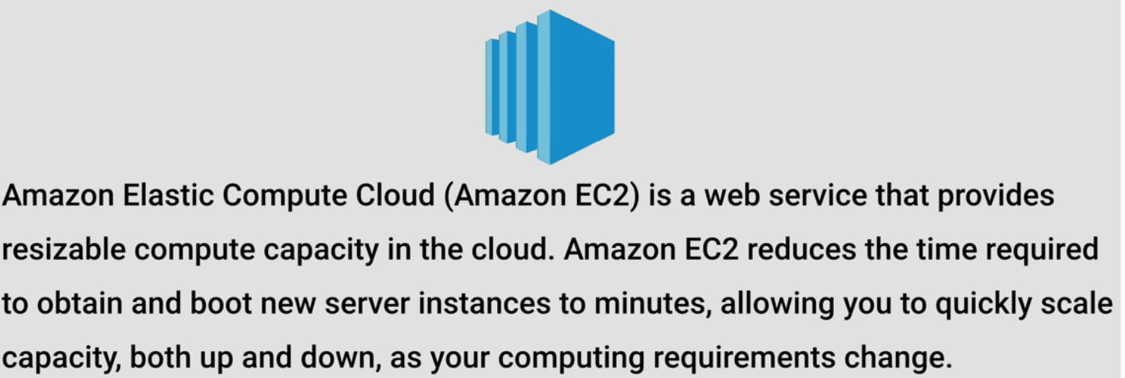
What is EC2 ?

Slide 11
EC2 Options
On Demand - allow you to pay a fixed rate by the hour with no commitment
Reserved - provide you with a capacity reservation ,and offer a significant discount on the hourly charge for an instance . 1 year or 3 year terms
Spot - enable you to bid whatever price you want for instance capacity , providing for even greater savings if your applications have flexible start and end times .

Slide 12
EC2 Options
On Demand
Reserved
Spot

Slide 13



EC2 Options
On Demand
Allows you to pay a fixed rate by the hour with no commitment
Reserved
Allows capacity reservation and significant discount on the hourly charge of the instance – 1 year or 3 years
Spot
Allows significant discount on the hourly charge of the instance – 1 year or 3 years

Slide 14
EC2 Instance Pricing
Click on the link given below to see the EC2 instance pricing
https://aws.amazon.com/ec2/pricing/

Slide 15
Spot Prices
If the Spot instance is terminated by Amazon EC2 ,you will not be charged for a partial hour of usage . However , if you terminate the instance yourself ,you will be charged for any hour in which the instance ran .

Slide 16
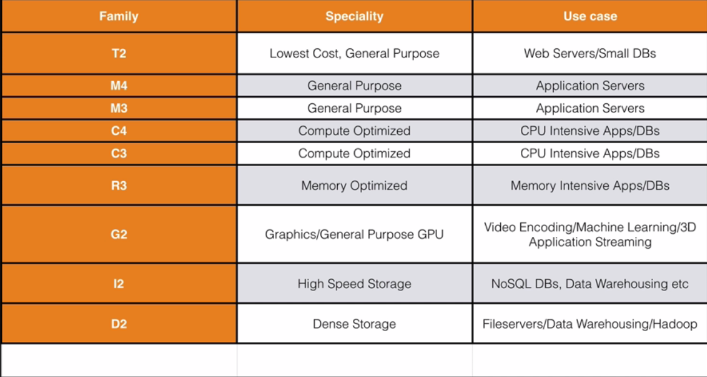
EC2 Instance Types

Slide 17
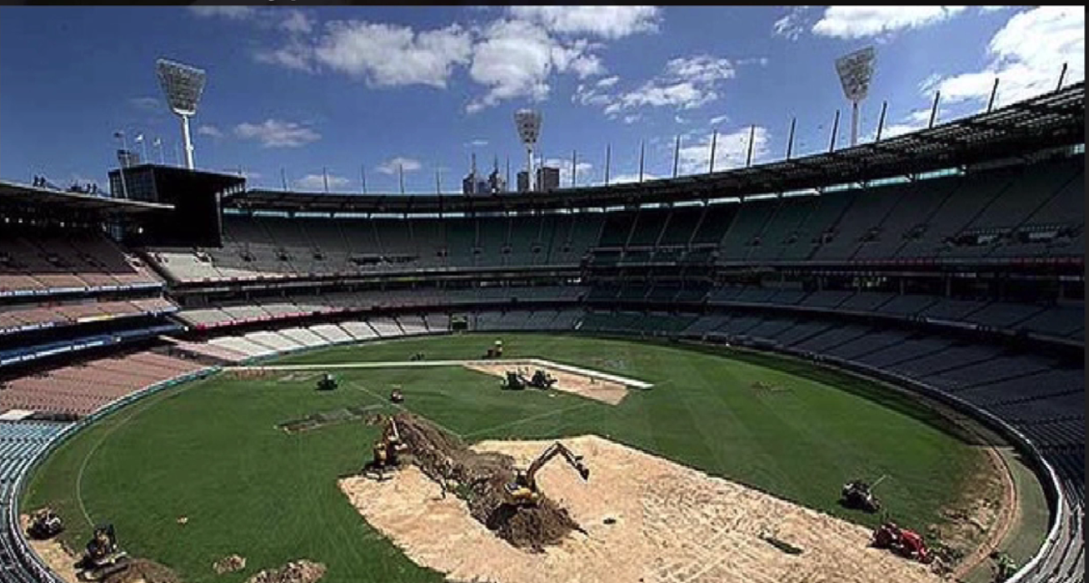
EC2 Instance Types - DIRTMCG

Slide 18
EC2 Instance Types
G
R
I
D
T
C
M
Graphics
Compute
Gen.Purp. Apps
Cheap General Purpose
RAM
IOPS
Density

Slide 19
What is EBS ?
Amazon EBS allows you to create storage volumes and attach them to Amazon EC2 instances . Once attached, you create a file system on top of these volumes ,run a database , or use them in any other way you would use a block device .Amazon EBS volumes are placed in a specific Availability Zone ,where they are automatically replicated to protect you from the failure of a single component .

Slide 20
EBS Volume Types
General Purpose SSD (GP2)
Designed for 99.999% availability
Ratio of 3 IOPS with per GB with up to 10,000 IOPS and the ability to burst up to 3000 IOPS for short periods for volumes under 1 Gib
Provisioned IOPS SSD (101)
Designed for I/O intensive applications such as large relational or NOSQL databases .Use if you need more than 10,000 IOPS
Magnetic (Standard)
Lowest cost per gigabyte of all EBS volume types .Magnetic volumes are ideal for workloads where data is accessed infrequently , and applications where the lowest storage cost is important

Slide 21

EBS
You cannot mount 1 EBS Volume to multiple EC2 instances,instead use EFS

Slide 22


ELB
ELB ‘s are not free , you are charged by the hour and on a per basis of usage .
Services which are free include Cloud Formation , Elastic Beanstalk ,Auto Scaling ,Opsworks

Slide 23
Supported ELB Protocols
HTTP
HTTPS (Secure HTTP)
TCP
SSL (Secure TCP )

Slide 24
Available SDK’s
Android ,iOS , JavaScript (Browser)
Java
.Net
Node.js
PHP
Python
Ruby
Go
C++

Slide 25
SDK ‘s Default Regions
Default Region US-EAST-1
Some have default regions (java)
Some do not (Node.js)

Slide 26
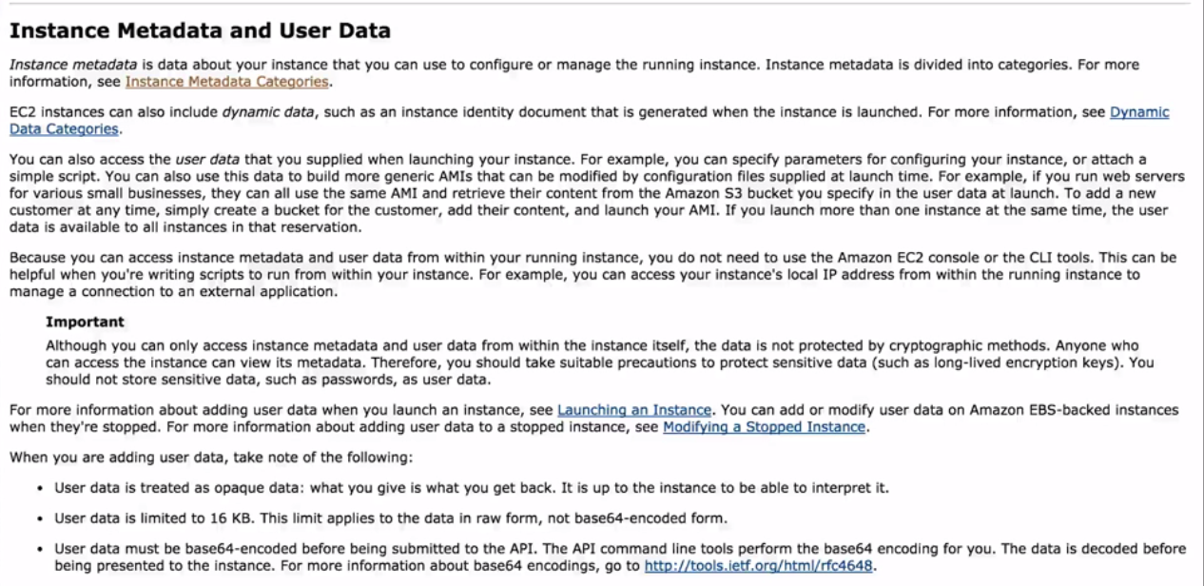
Instance Metadata

Slide 27
Summary
Learnt what is EC2
EC2 Options and Pricing – On Demand , Reserved , Spot
EC2 Instance Types
What is ELB
EBS Volume Types
Default regions
Instance Metadata

